Slide 1

ECON251 Industry and Trade in Asia
Navigating data sites on external economy
United nations- UNCTAD data

Slide 2

Key Objectives
To navigate key international data sites to extract data on the external economy
Do note there is no best site as each site serves different purpose
The demo provides key navigation of most sites , students are to explore further on their own
We will also explore the use of pie charts , stacked bar charts to further enhance our data visualization

Slide 3
UNCTAD – United Nations conference on Trade and Industry
Key data series
Trade Policy Indicators: Primarily tariffs (use weighted average tariff on all goods) , To assess the policy environment supporting or hindering outward orientation.
Exchange Rate Trends: Affecting export competitiveness.
Basis of trade : Revealed comparative advantage to determine which goods/industry for specialisation and export
FDI data: Inward and outward Foreign Direct Investment can indicate how integrated a country is into global production networks.

Slide 4
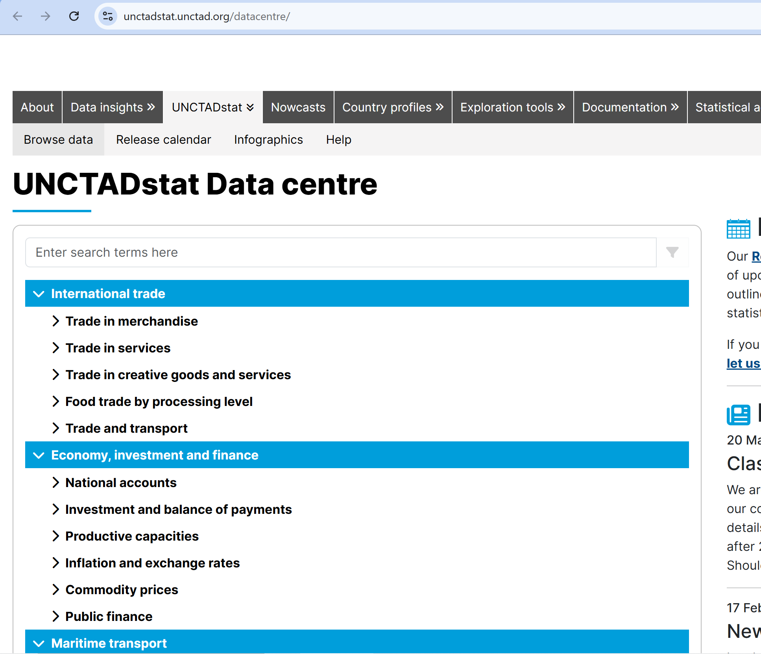
UNCTAD – General Overview
https://unctadstat.unctad.org/datacentre/

Slide 5
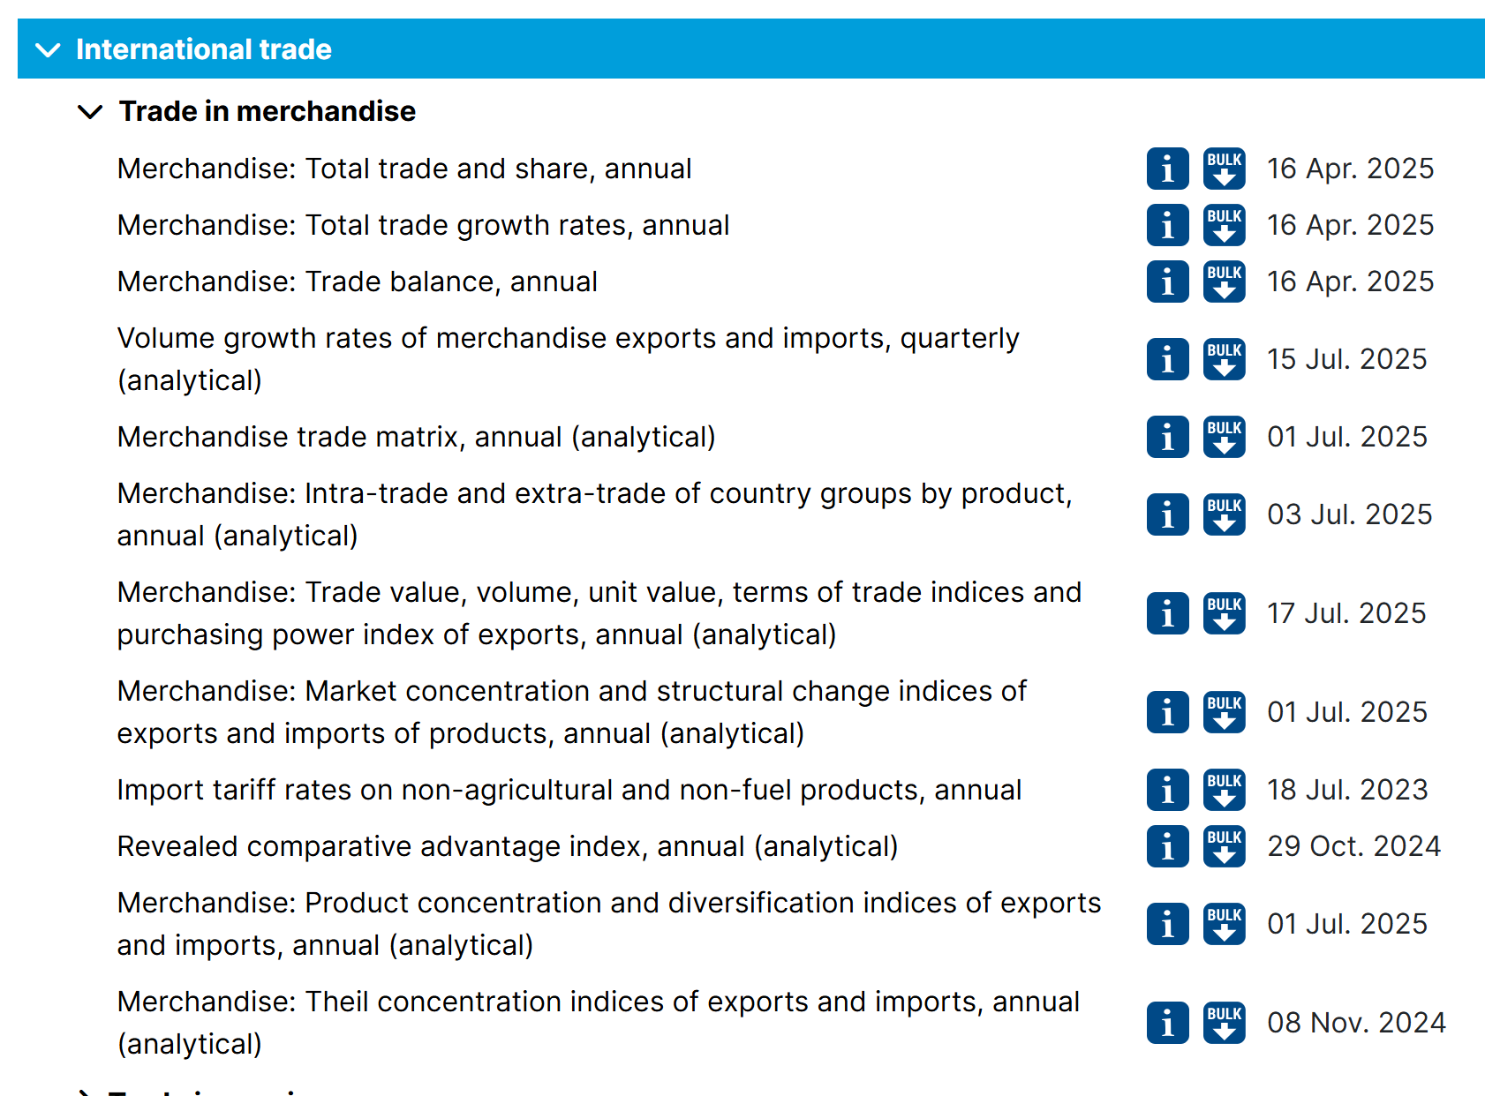
Key data series

Slide 6
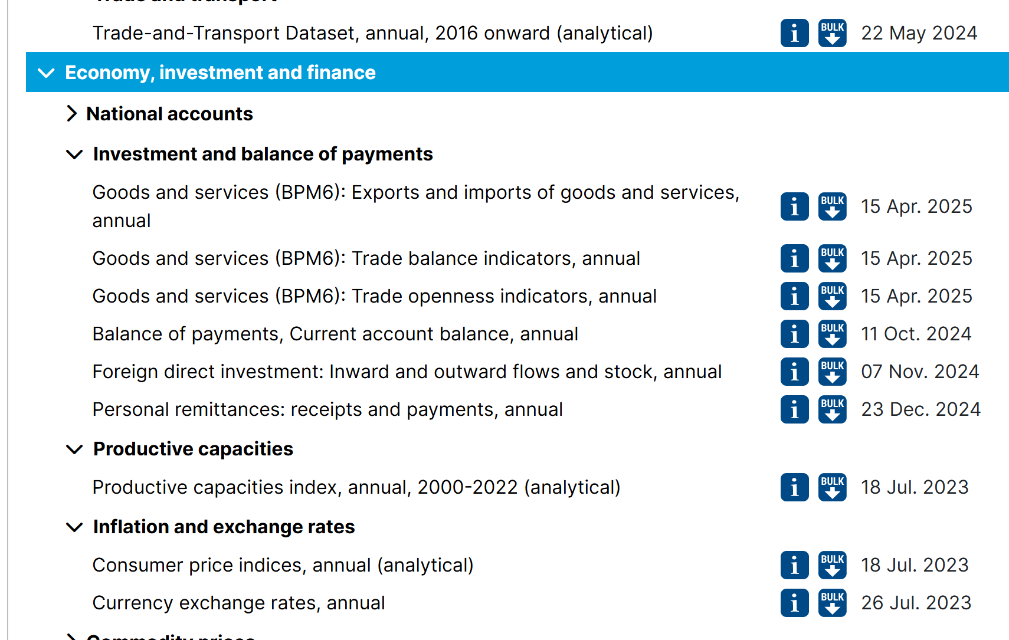
Key data series

Slide 7
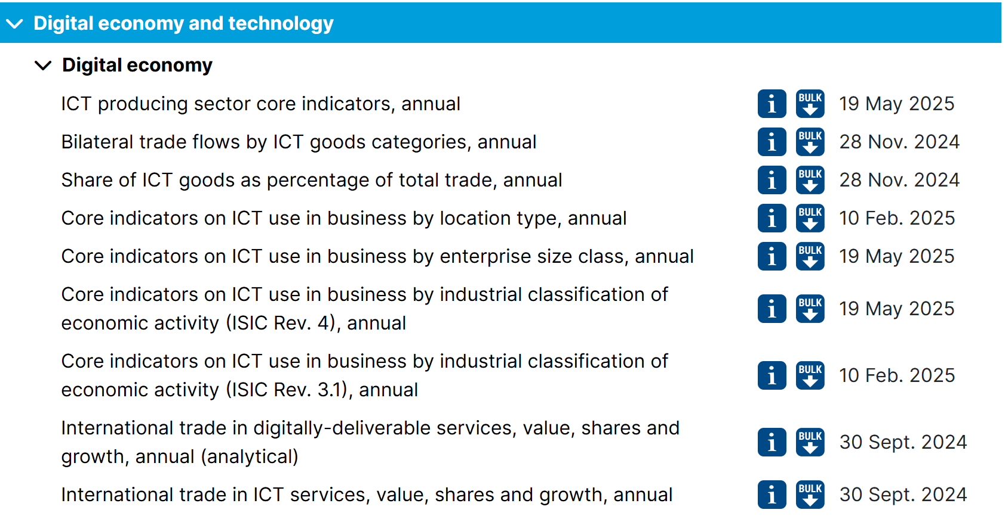
Key data series

Slide 8
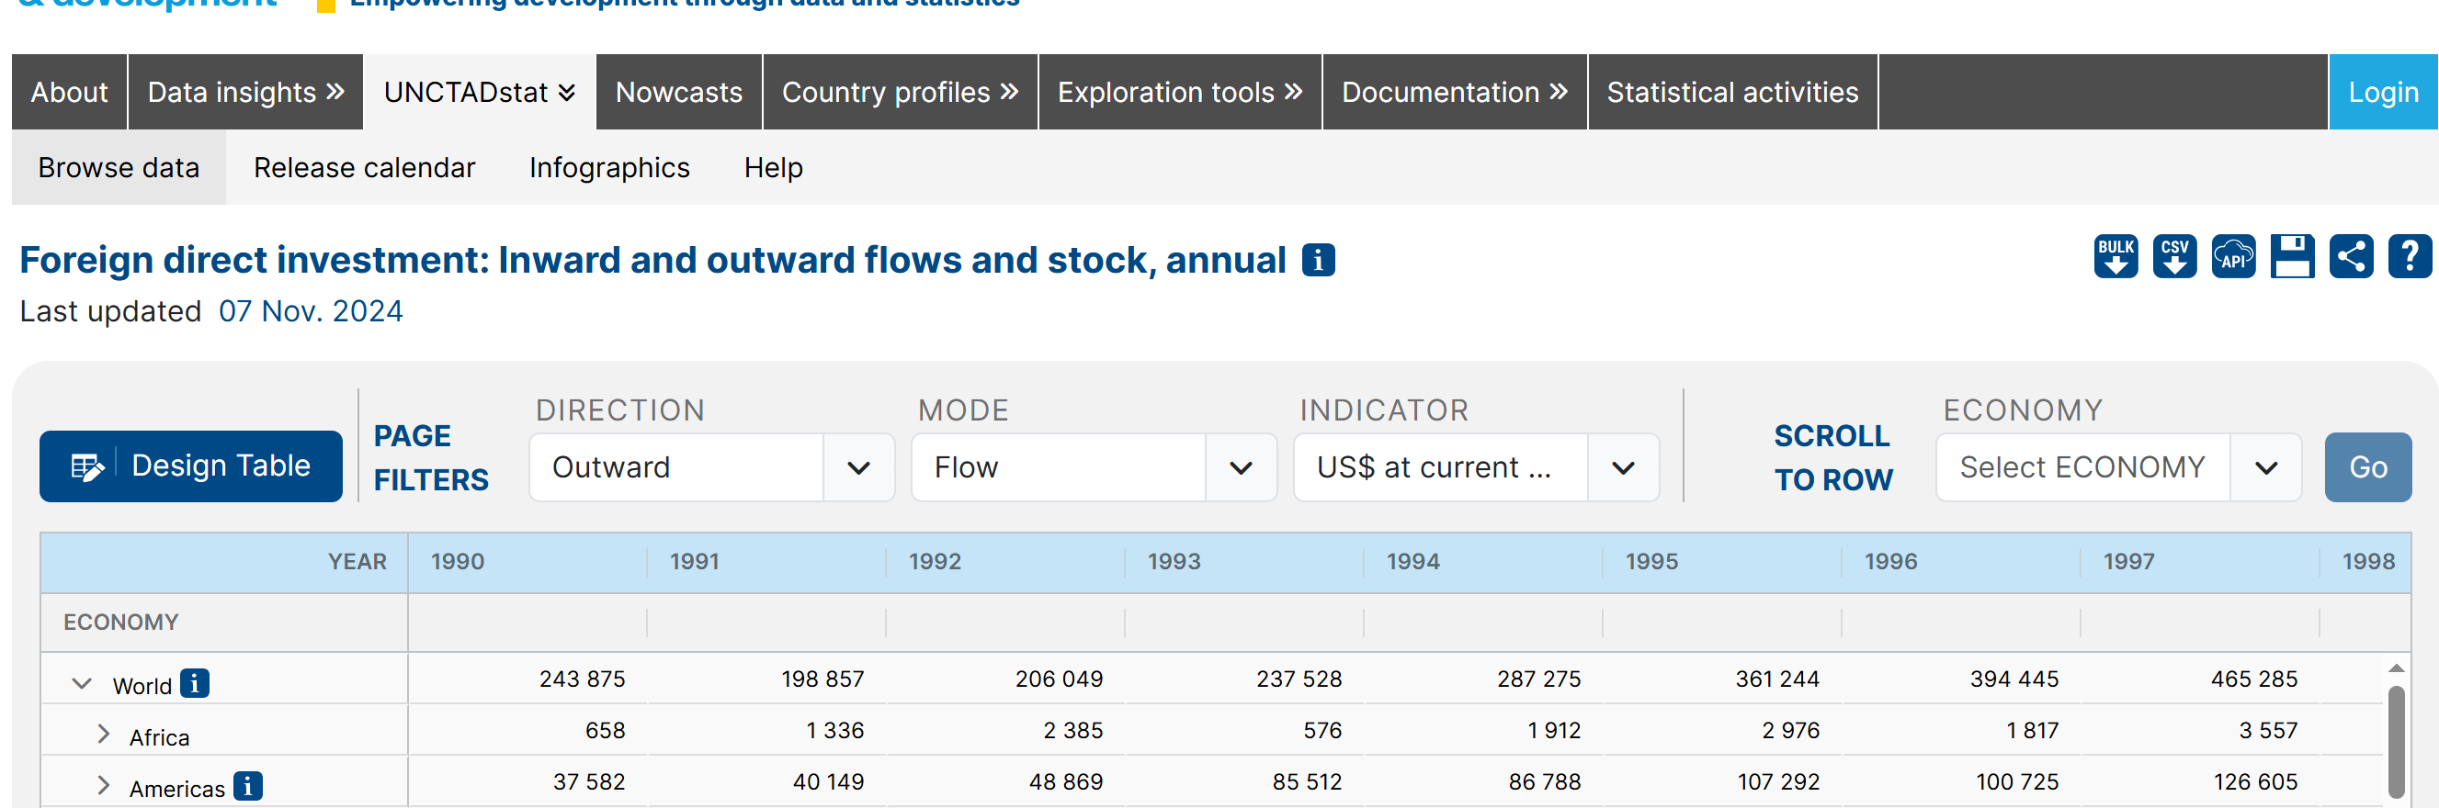
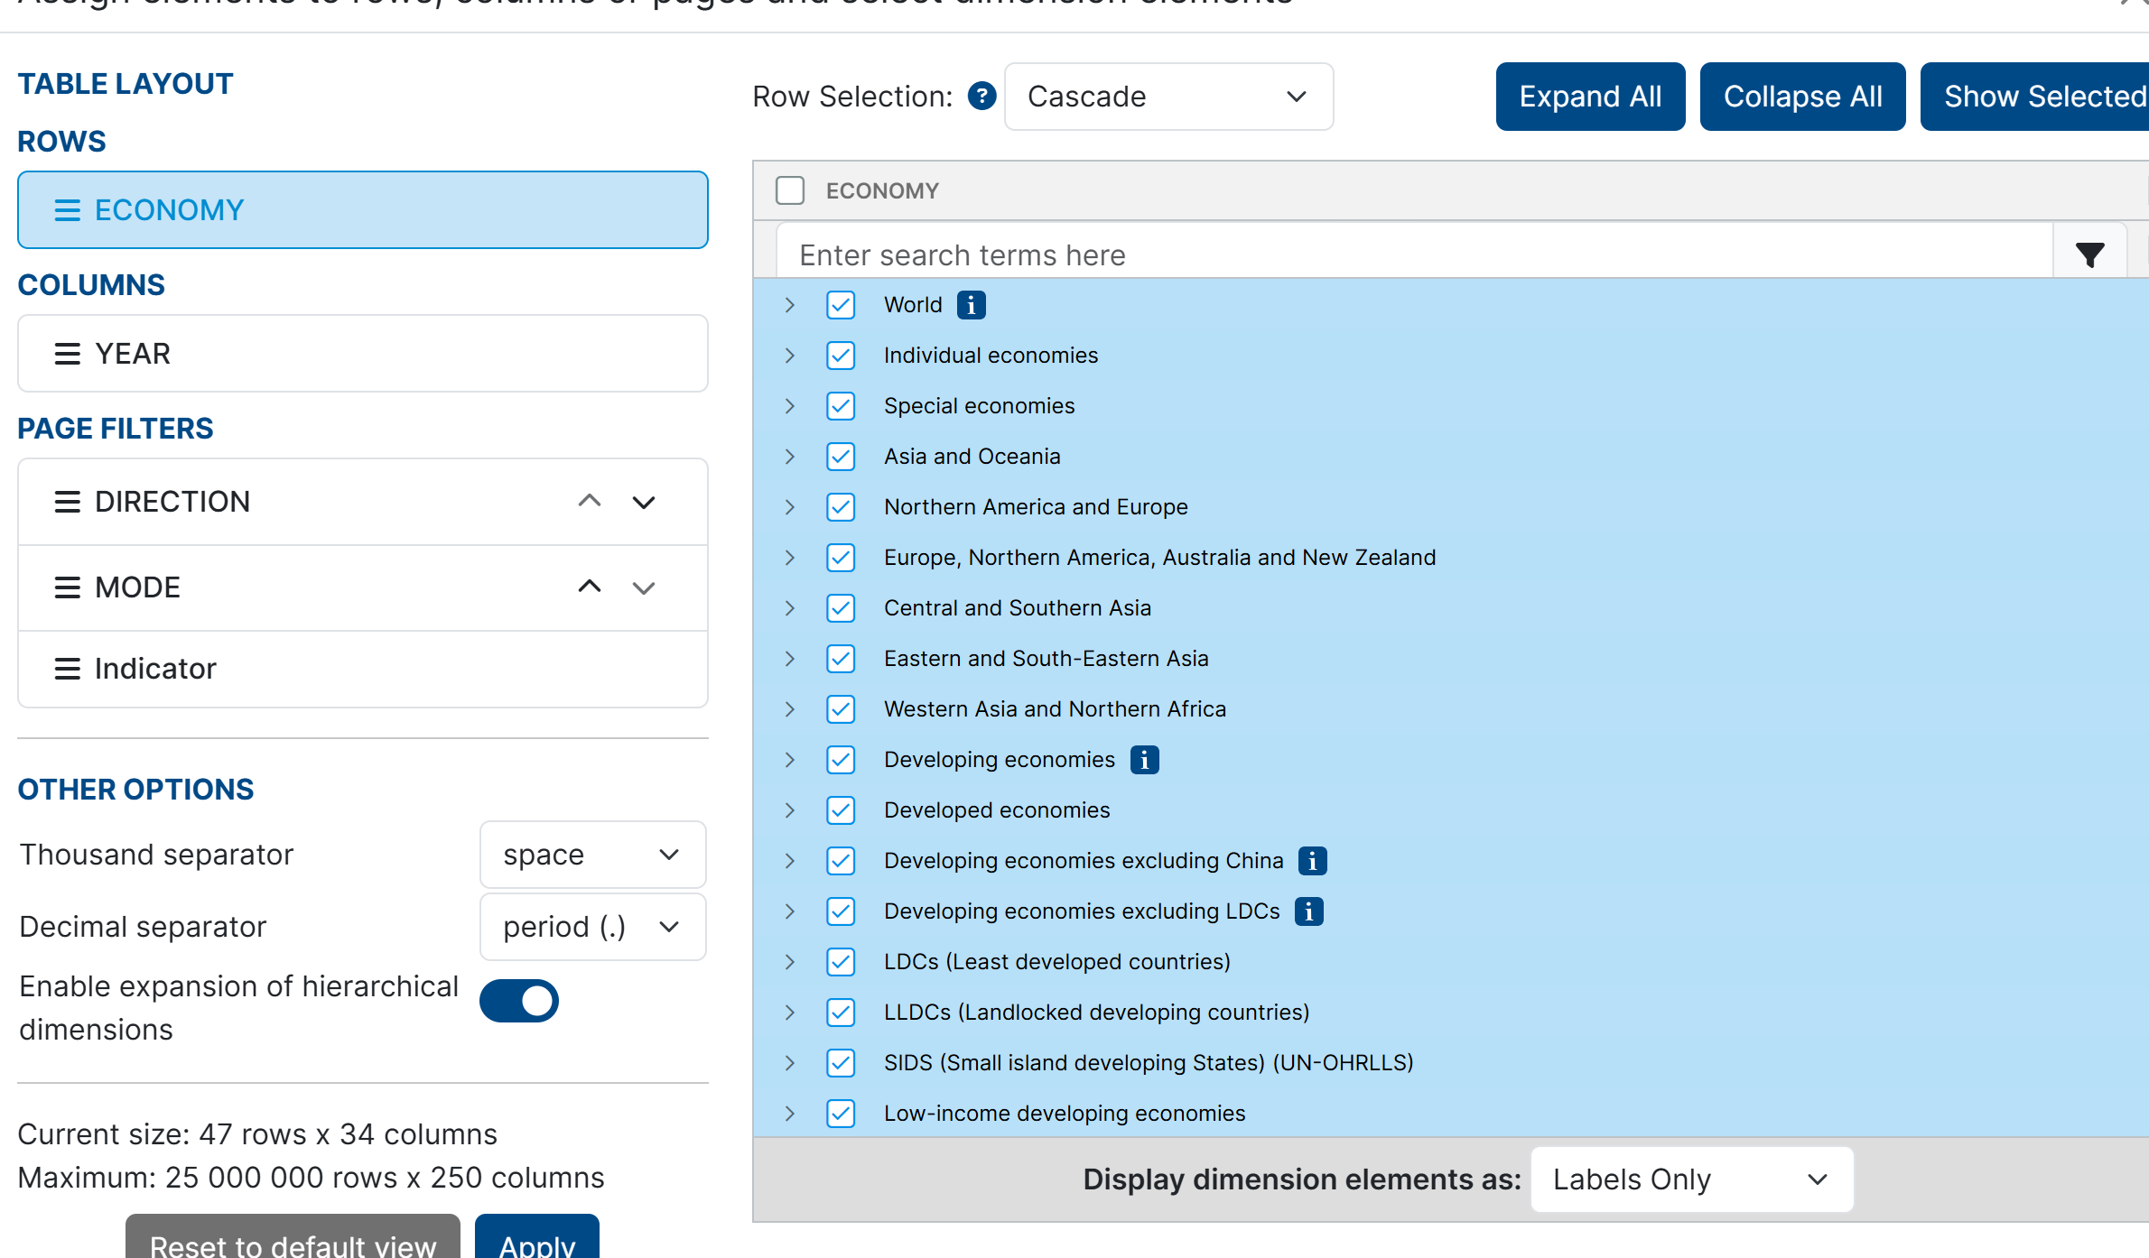
Navigating the UNCTAD data site
From 1990 to 2025
3. Navigate the Desing table page
Select on data series and go to step 2
4
2
5
6

Slide 9
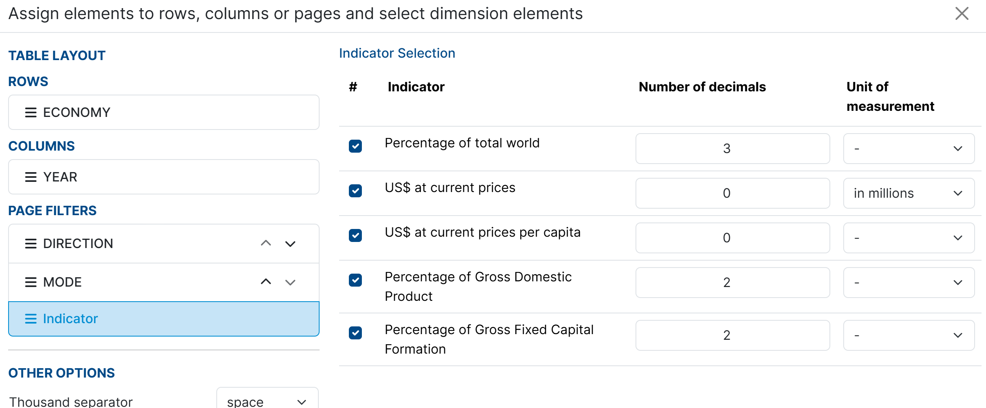
Navigating the UNCTAD data site
3. Navigate the Design table page
7
6

Slide 10
Navigating the UNCTAD data site
8. Extract data for specific country/region and download as csv file
9
8

Slide 11
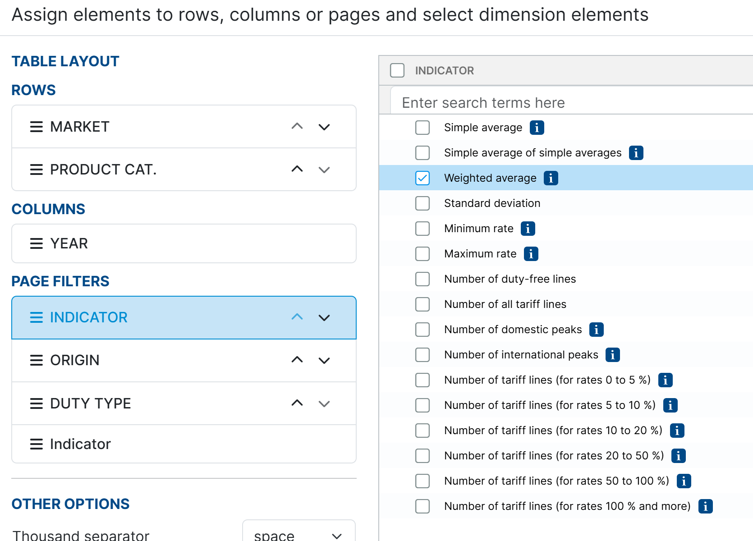
Demo on extracting data on tariffs
You should be expecting quite a fair bit of missing data; apply linear interpolation where applicable ; Do not if the given shows 0, do not treat it as missing values
2
4
3

Slide 12
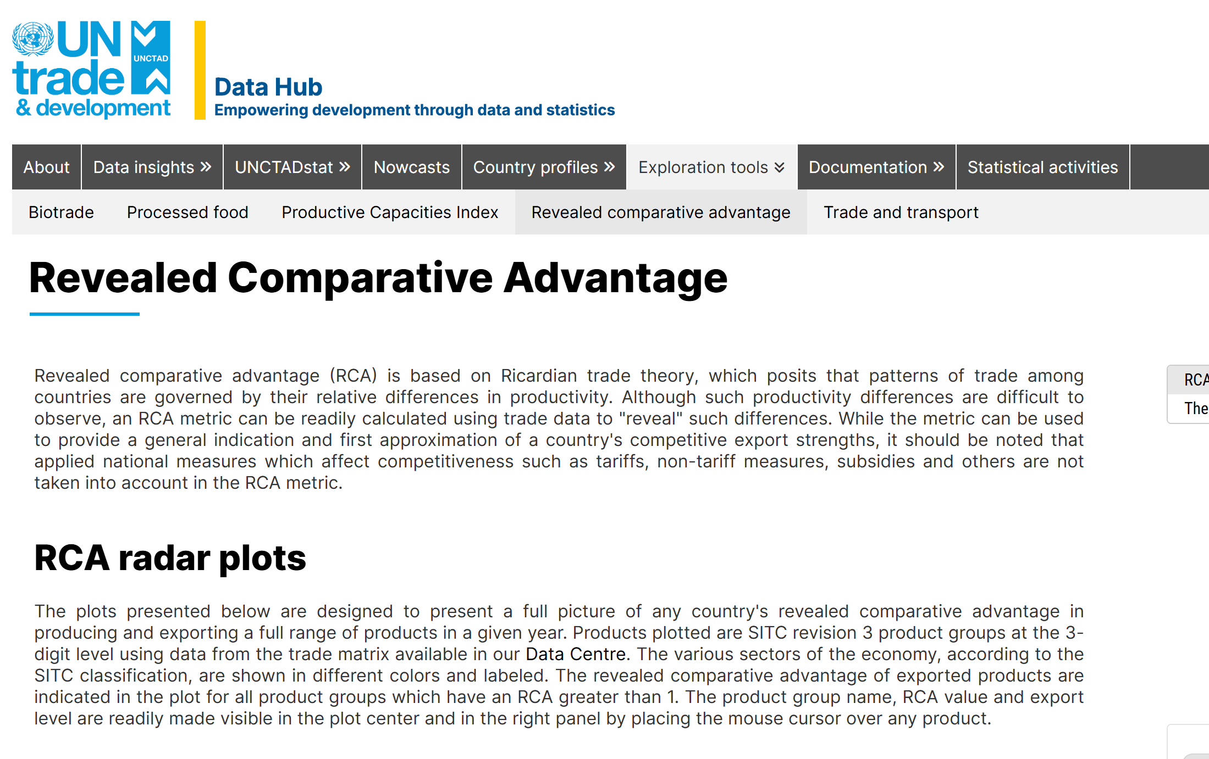
Revealed Comparative Advantage
1
2

Slide 13
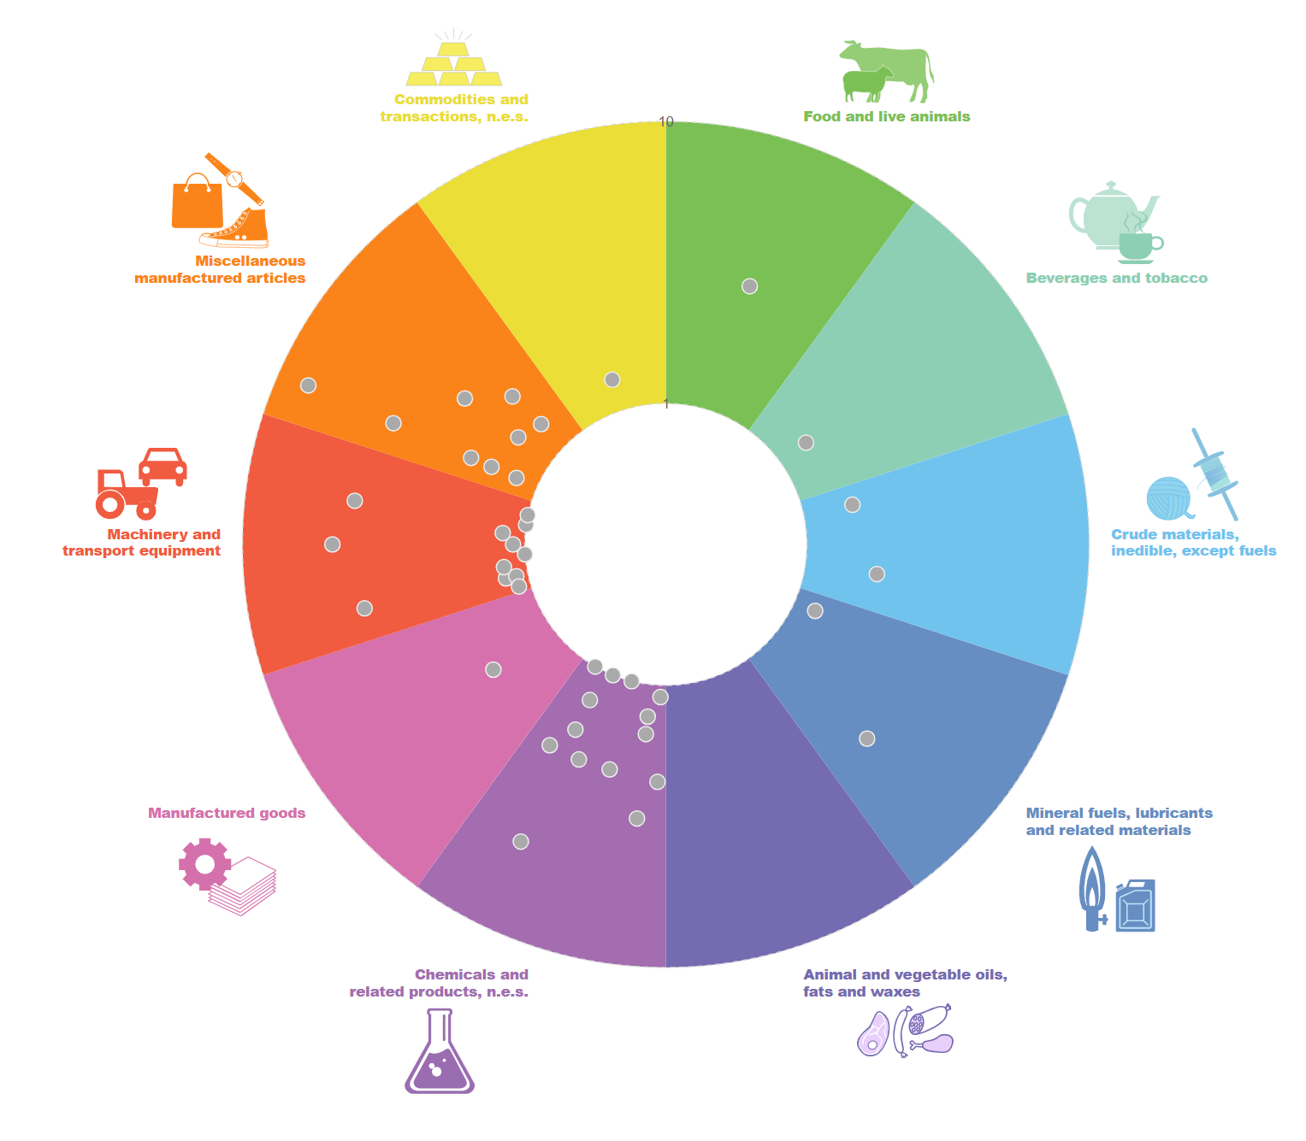
Demo on RCA of Singapore
Only for this case you are allowed to screen shot the radar plot diagram as provided by UNCTAD
The dots appearing are the goods/products under the various industries that the economy face comparative advantage and thus will export the good(s)
As observed, SG’s RCA lies on Chemicals and related products followed by machinery and transport equipment
In each category, mouse over to obtain the specific RCA value

Slide 14
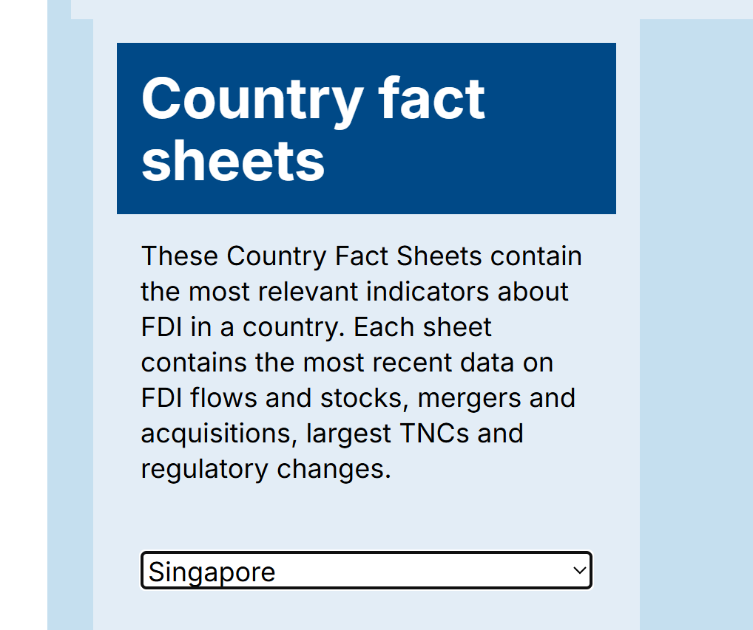
UNCTAD data on FDI
https://unctad.org/topic/investment/world-investment-report for a global perspective
Data on the country's FDI flow and sources for the period of 2021 to 2025 and the 2 key sources of flow
International trade centre : Investment Map
https://www.investmentmap.org/investment/indicators-by-country

Slide 15
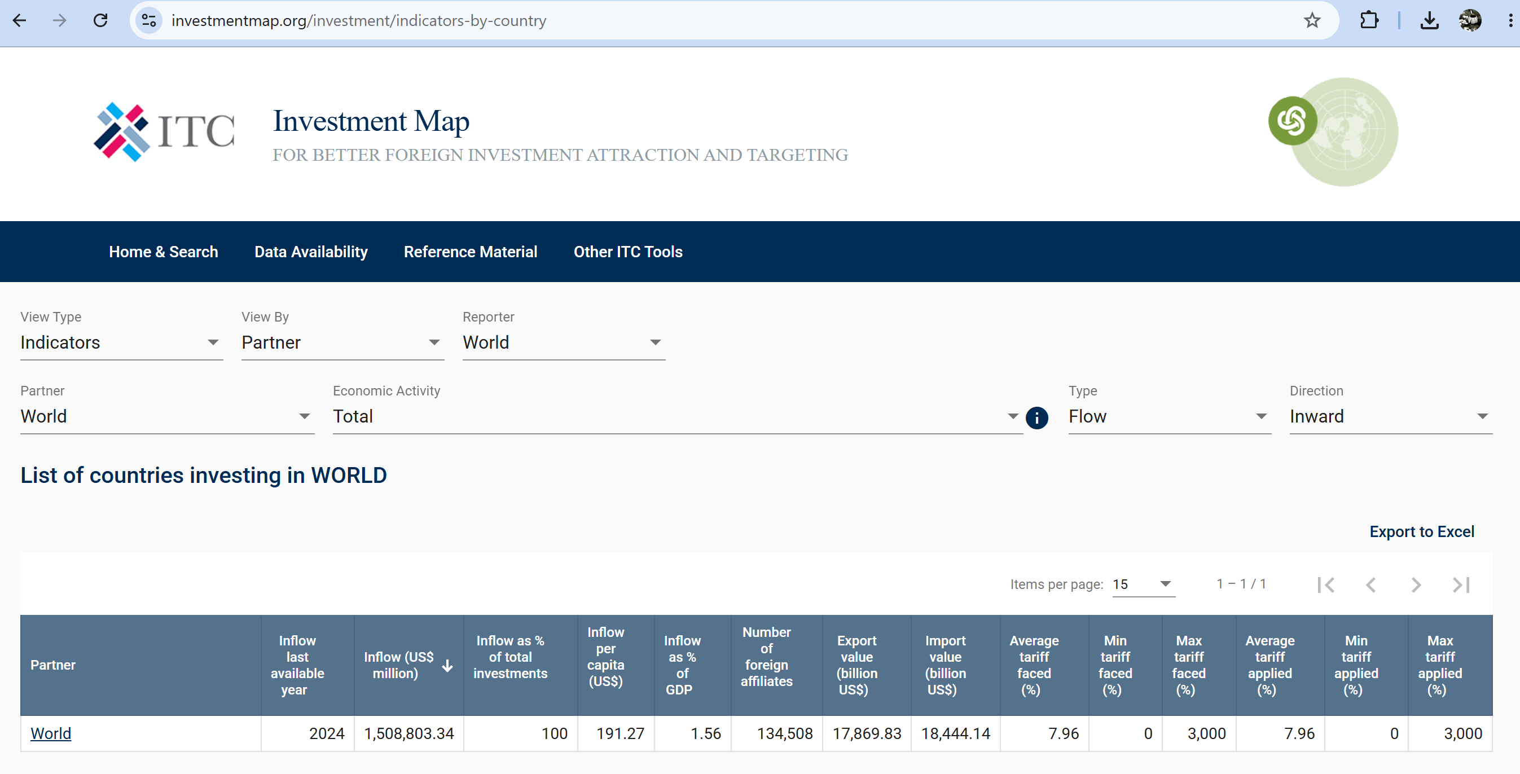
Data provided is only for 1 year but we can navigate for the bilateral relationship
1
2
4
3

